Slide 1

C.D.R.
Smart Surveillance Hub
By: Matthew Weinert, Korey Lombardi, Kenneth Ancrum, Joshua Sherrill
Group 15

Slide 2
Overview
Project rundown
Roles & responsibilities
Budget
Software
Firmware / OpenCV
Electrical Schematic / Design
Progress
Issues & upcoming tasks

Slide 3
Our Team
Matthew Weinert CPE - Frontend/Backend Developer
Korey Lombardi CPE - Firmware/Backend Developer
Kenneth Ancrum EE - Hardware/Firmware
Joshua Sherrill EE - Hardware/Firmware

Slide 4
The Problem
Do it yourself security is expensive and there are little options on the market for a full security system that can be self monitored.
Home Security companies gouge customers with subpar products because of lack of competition.
Lack of flexibility when it comes to a home security system.
Lack of features, such as Detection software and 3rd-party peripheral compatibility.

Slide 5
Our Project
The smart hub at its core functionality is a smart detection system, where users can purchase any IP camera off the market and connect it directly to the hub.
The hub will use our smart detection technology to alert the user when someone is in the view of the camera by an alarm and changing led lights.
The goal of this project is deliver a functioning smart detection system.

Slide 6
Stretch Goals
Cloud Storage Capability
Mobile Application
Backup Battery
Adding increased range of IP cameras supported
Ability to cast and receive data
2 way communication via the hub and the camera
Screenshot Capability

Slide 7
Roles & Responsibilities
Matt Weinert | Handle all of the user facing interfaces, such as the smart hub control features.
Korey Lombardi | Handling all of the firmware communication such as control of the LEDs and Audio.
Kenneth Ancrum | Develop the Hardware design and overall board design for custom PCB, as well as audio and power design
Joshua Sherrill | Assist with the Audio development, handle the LED design, work on the housing for the project.

Slide 8
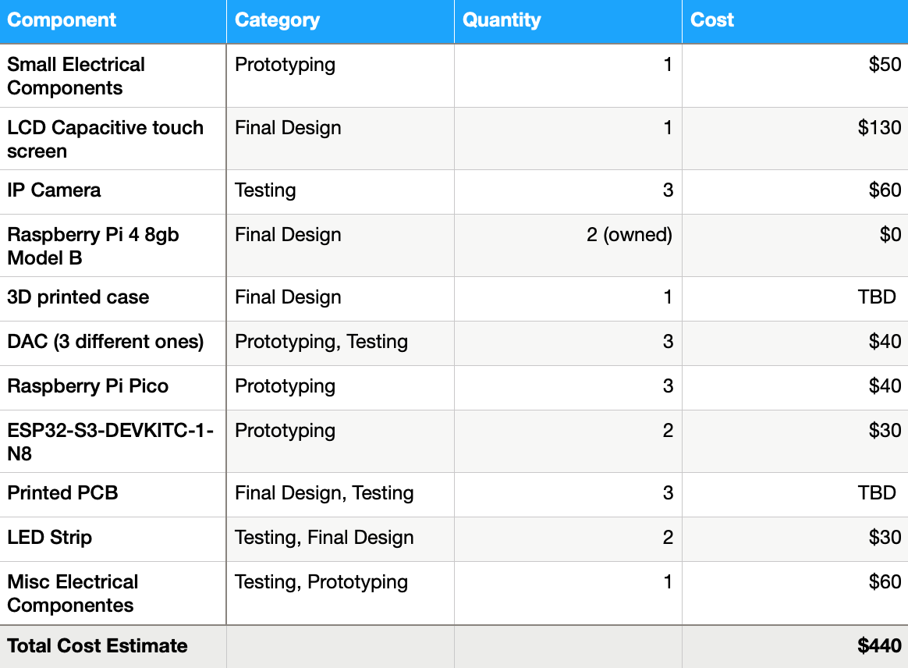
Budget

Slide 9




Software (Application)
What is required of the project on the software side:
Desktop Application
Can interface with MCU
Support for ML human detection
Portable
Multithreaded
Can achieve our deliverables
  Streaming live video
  Saving video
  Watching old streams

Slide 10
Software Stack:
Python vs. Node
Node:
Javascript ES6
ElectronJS
  Application GUI framework
TensorFlow
  Computer vision library
FFMPEG
  Video streaming software
MicroPythonJS
  Interfacing software

Slide 11
Software Stack:
Python vs. Node
Python:
Python & Micropython
PYQT5
  Application GUI framework
PyInstaller
  Package creator
OpenCV
  Video streaming software
  Computer vision library

Slide 12
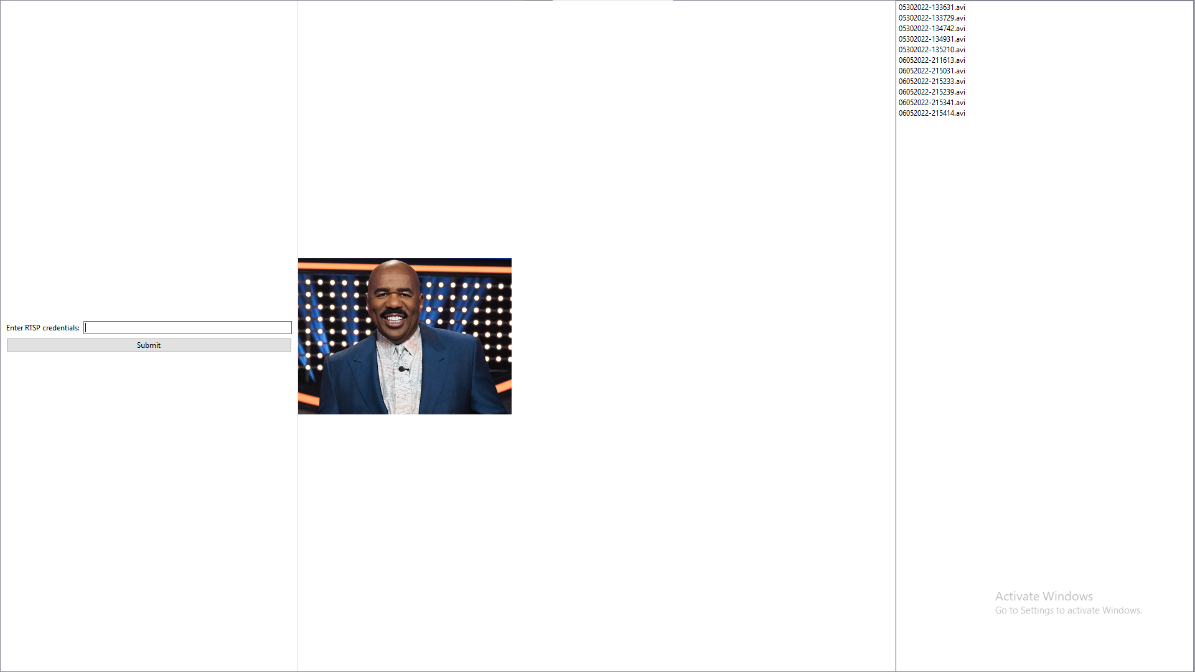
Graphical
User
Interface

Slide 13
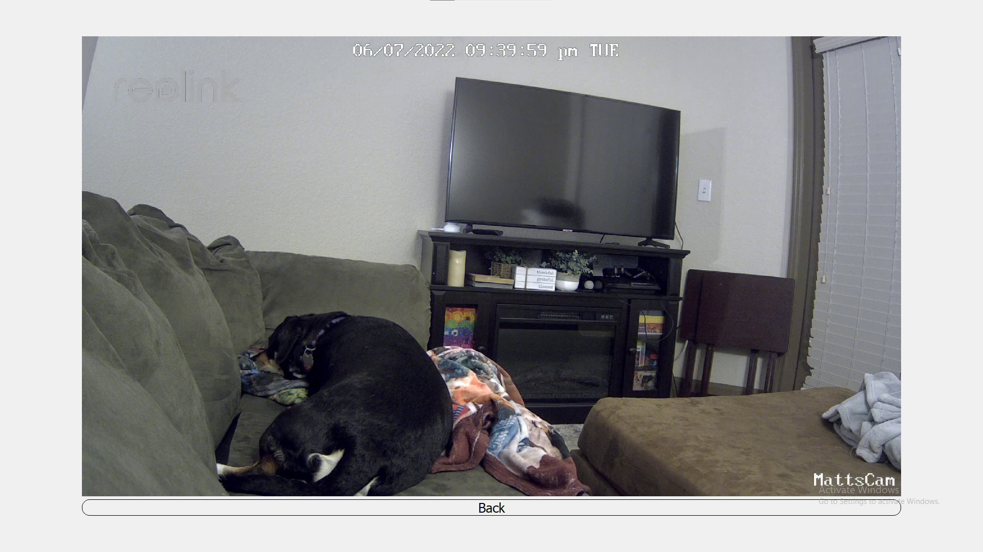
GUI
Live
Feed

Slide 14
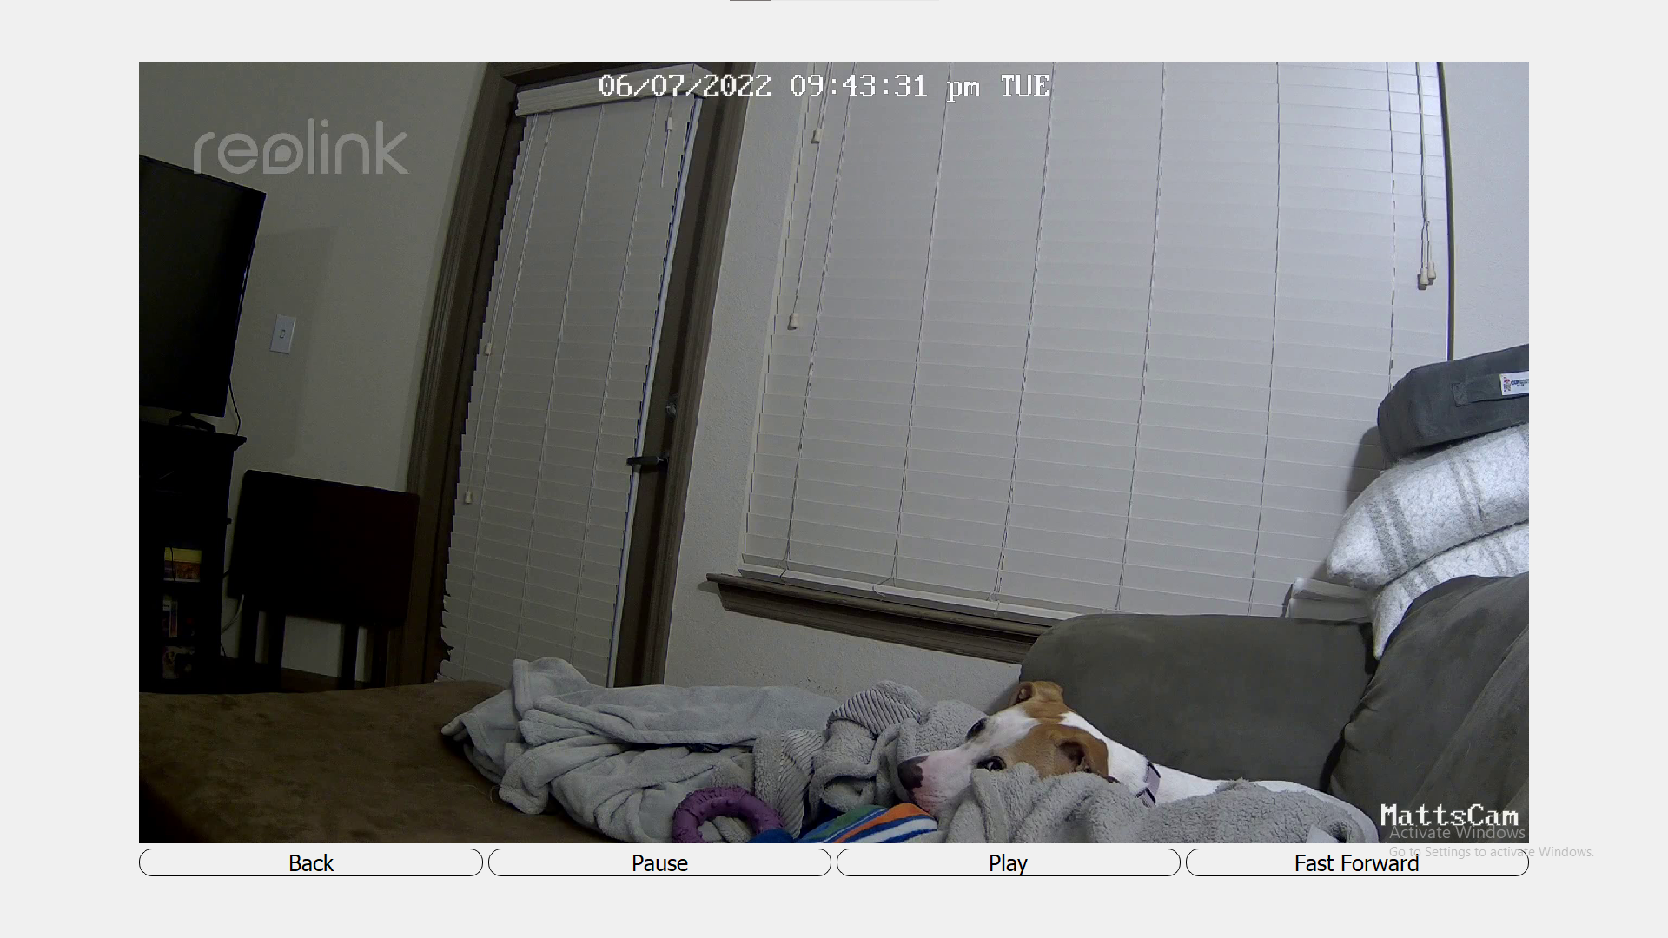
GUI
Playback
Feed

Slide 15
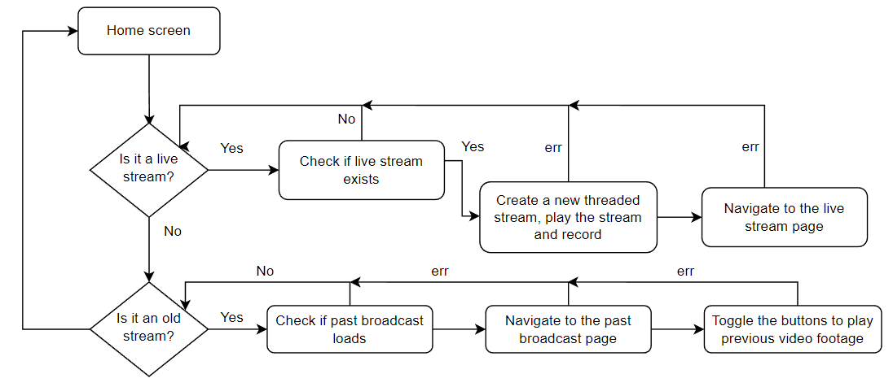
Software
Flowchart

Slide 16
Key Software Takeaways
Multithreaded
  Each video has its own thread dedicated to the video stream, this makes the application scalable; this makes our stretch goal of multiple streaming concurrently running possible without data leaks.
Error checking
  Preventing the user to input or use bad or faulty data, such as a bad RTSP url or if the camera disconnects the user’s directed back to the home page.
Portable
  The Raspberry Pi O.S. is Raspbian, which is linux based and our targeted platform, but the software can also run on Windows or MacOS.
Universal
  RTSP streams are universal to all IP cameras, which allows this application to easily interface with most (if not all) IP cameras.

Slide 17
Human Detection Software
Our application’s human detection capability is implemented using OpenCV, a popular computer vision library.
  OpenCV provides a method named HOG (Histograms of Oriented Gradients) that’s made exclusively for detecting pedestrians.
  This method works best when a person is in full view of the camera’s display with both of their arms and legs in sight.
The default parameters used for detection slowed down our applications performance. To maximize application performance we increased the winstride and scale parameters.
Consecutive detections are made for each human.
  We built a timer in the software to keep the system from alerting the user everytime opencv makes a consecutive detection on one person.

Slide 18
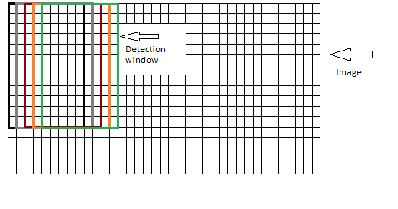
Modifying Human Detection Parameters
The camera captures each frame containing 1920x1080 pixels.
  Resizing each frame to 400x225 pixels was ideal for accuracy and performance.
The detection algorithm uses a winstride technique that iterates over the pixels of each frame.
  The default winstride with parameters of (4,4) was slowing down our applications performance causing the live video stream to lag.
  Changing the winstride parameters to (8,8) improved application performance while maintaining accuracy.

Slide 19
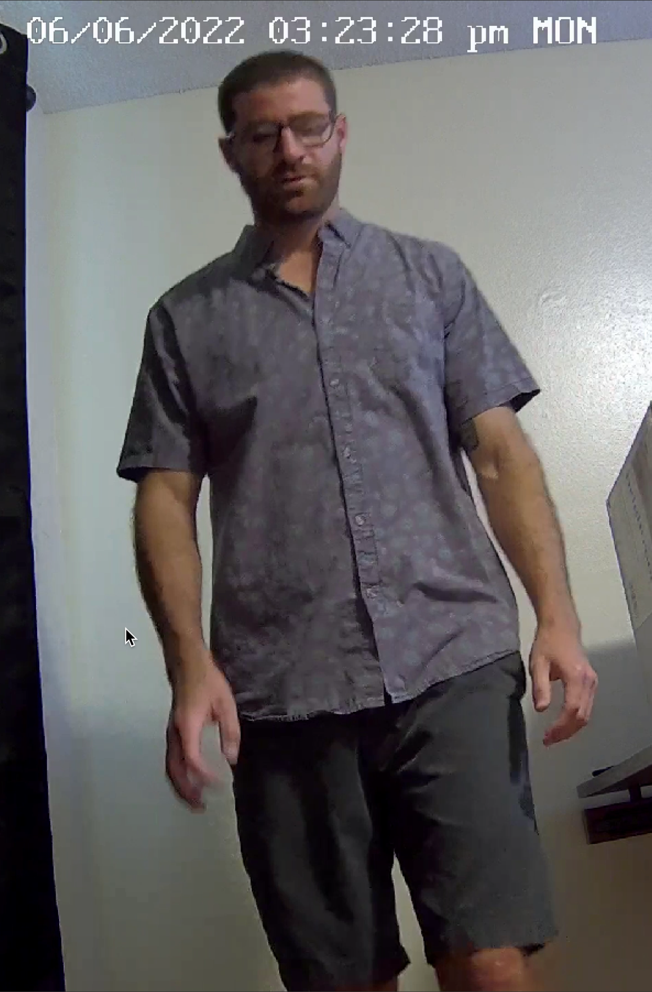
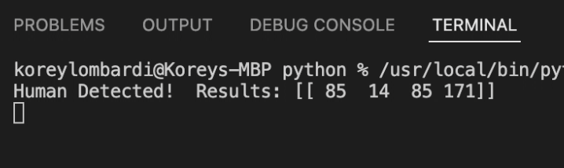
Testing Human Detection Performance
Below is a tested human detection with its output in the terminal. The numbers inside the brackets are the coordinates of where the human was found within the frame.

Slide 20
CircuitPython vs MicroPython
CircuitPython
Programming language based on Python and MicroPython designed to interact with microcontrollers.
It was built specifically for adafruit boards.
Only one file can be run at a time.
Code is executed at startup of device or reload and can’t be ran again.
Simpler but less flexible than MicroPython.
MicroPython
Python based programming language designed for interacting with microcontrollers.
Multiple files can be run at the same time allowing state to be shared.
Files can be executed more than once.
Offers more flexibility but also more complex than CircuitPython.

Slide 21
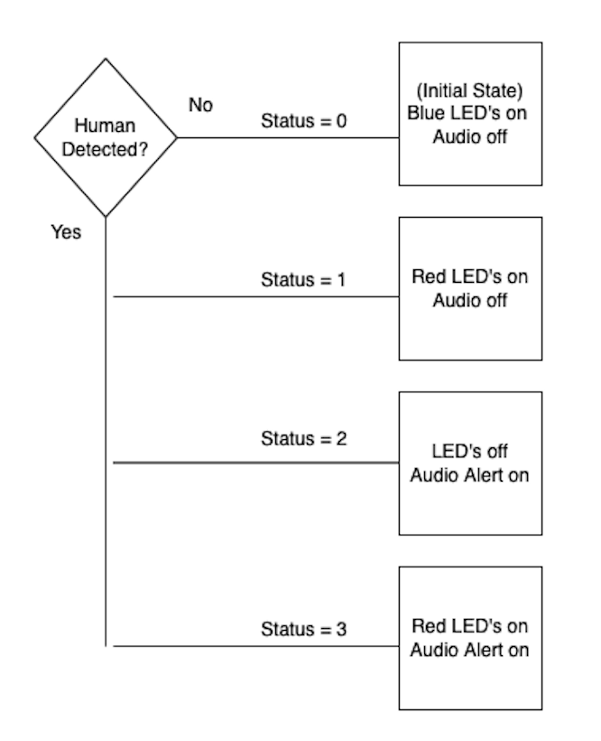
Communicating with the Microcontroller
The signals are transmitted from the Raspberry Pi and received from the microcontroller via USB serial communication.
Once the signal is received by the microcontroller, it triggers the necessary functions to activate the peripherals attached to the microcontroller.
The functionality controlling the peripherals is controlled by a single python file that’s flashed to the microcontroller.
  Python file runs every time microcontroller boots.

Slide 22
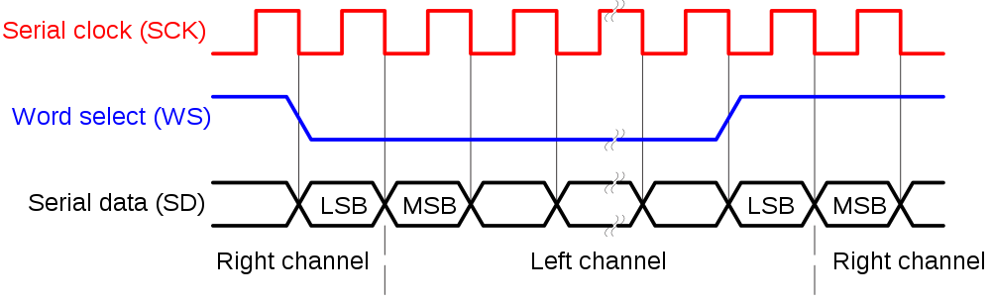
Audio Playback using I2S
I2S is the standard used for digital audio communication between the Raspberry Pi Pico and the speakers attached to the Smart Hub device.
There are three necessary connections
  Bit clock or serial clock
  Word select
  Serial data

Slide 23



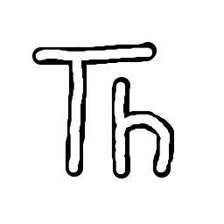
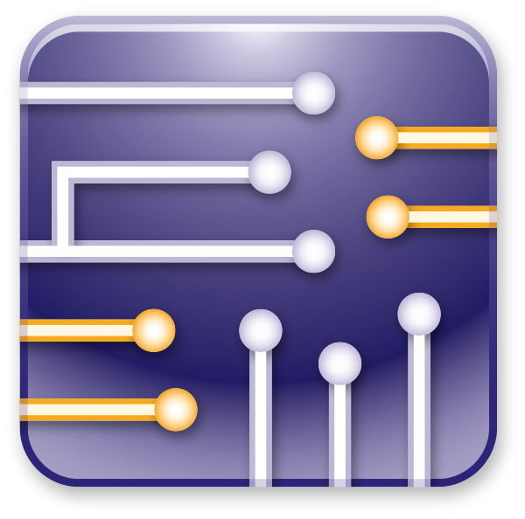
Development Environments Used
Fusion 360 & Eagle
3D modeling and ECAD schematic design
Multisim
For schematic analysis and simulation
Thonny & Visual studio
For Python and CircuitPython programming

Slide 24
Hardware

Slide 25
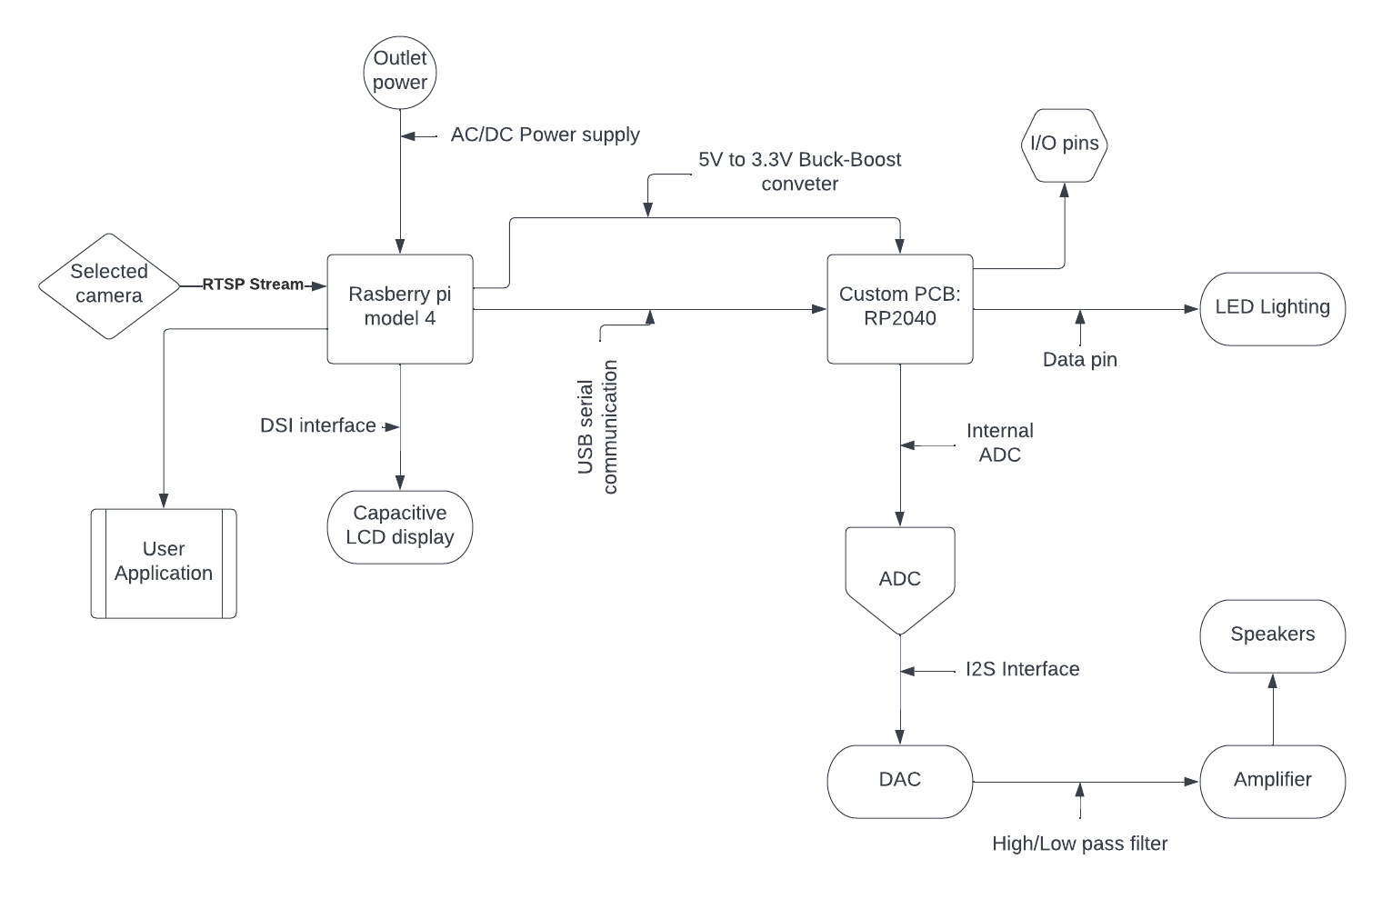
Hardware Diagram
Raspberry Pi 4
The responsibilities of the raspberry pi are related to higher computation, front and back and software, driver for the main display, and communication with our Custom PCB
Custom PCB (MCU)
Back end software as well as sound and lighting peripherals, Low noise and Low power designed for constant usage
Low profile sizing
Designed for mobility and lower power usage making compatibility in smaller settings easier

Slide 26
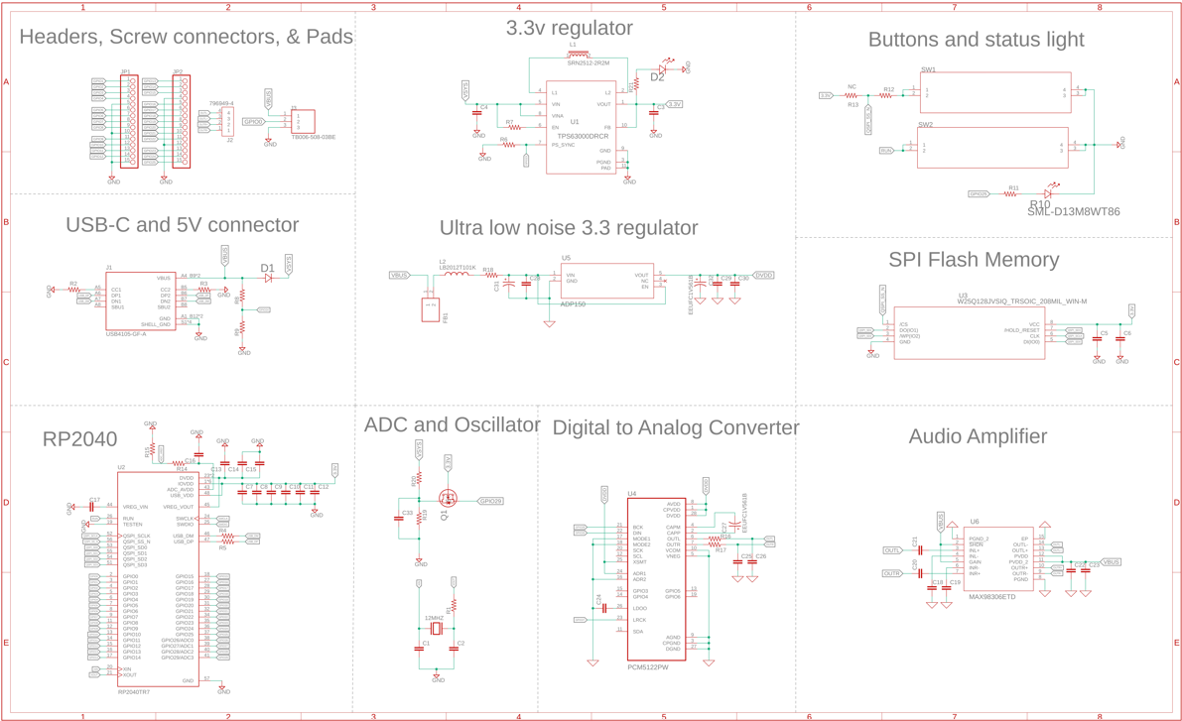
Overall EAGLE Schematic

Slide 27
Microcontroller options
RP2040 | ESP-S3
Dual-core Arm Cortex-M0+ | Dual high performance Xtensa® 32-bit LX7 CPU cores
264KB on-chip SRAM | Ultra Low Power co-processor
8 × Programmable I/O (PIO) state machines | Wi-Fi (2.4 GHz band)Bluetooth Low Energy
Low-power sleep and dormant modes | Lots of library support
Unit price- $1 | Unit price- $1.85
Selection Parameters
Fast clock speeds
Onboard Analog to Digital Converter
Plenty of GPIO pins
extensive library support

Slide 28
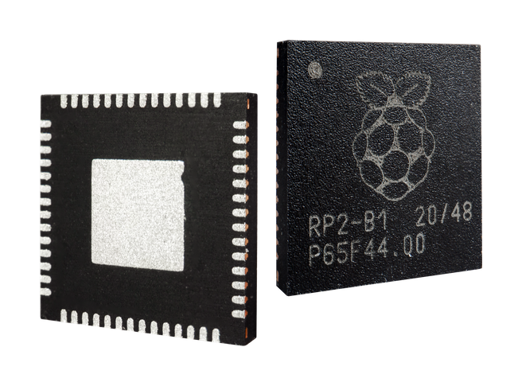
RP2040
Microcontroller
Chosen for………
Dual-core Arm Cortex-M0+ processor, flexible clock running up to 133 MHz
Has support for popular IDEs, such as Visual studio, Arduino, and Thonny
Low power modes
Large community support on the Raspberry Pi platform
PIO state machines for custom peripherals
And ability to supply flash memory up to 16MB for boot rom

Slide 29
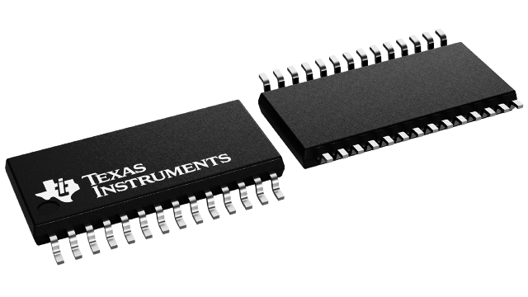
Digital to Analog Converter
PLL Clock Generation
The internal phase loop lock takes signals from the audio data receiver form clock timing generation. Without the presence of a Master clock we can still operate in I2S interface form simple quality sound.
Volume Control
The PCM5122 is the updated version of Texas Instruments PCM line of DAC converters, which allows for digital controls such as Volume control and automute functions.
Support for standard interfaces
The the IC has three modes two of which allows for I2C and SPI making programming and firmware implementation super simple.
PCM5122
Software and hardware configurable for I2C,I2S,SPI
Integrated PLL to drive system clock
Accepts 16-, 20-, 24-, and 32-Bit Audio Data
Automatic Power-Save Mode
Cost-$6.53

Slide 30
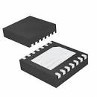
MAX98306ETD+T
Pop suppression
During startup, the click-and-pop suppression circuit reduces any audible transient sources internal to the device. When entering shutdown, the differential speaker outputs ramp down to PGND quickly and simultaneously
Class D amplifier performance
Although the amplifier is classified and configured as an AB amplifier its gives Class D performance, for which MOSFETs) operate as electronic switches, and not as linear gain devices as in other amplifiers.
Output Power 3.7W at 3Ω with 5V Supply
Click-and-Pop Suppression
Class D Speaker Amplifier
Gain selection

Slide 31
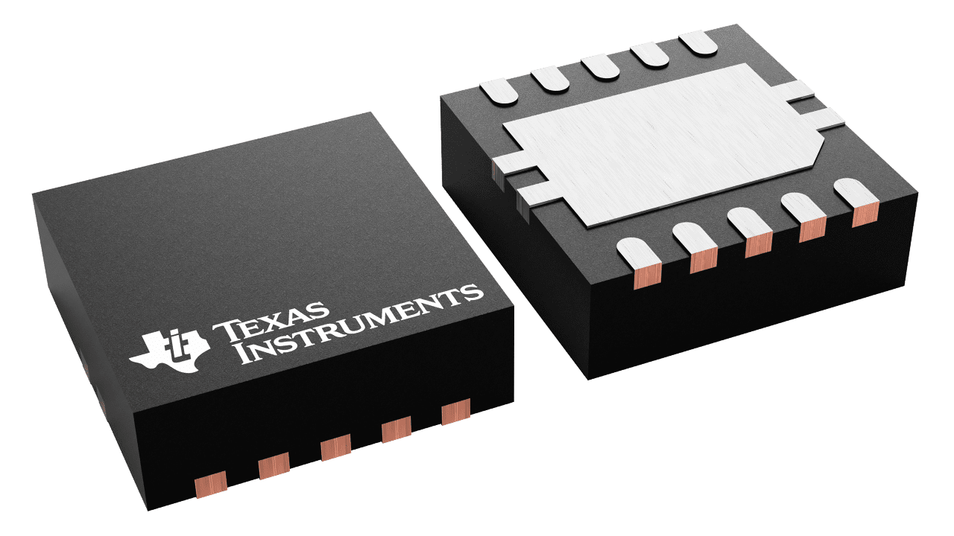
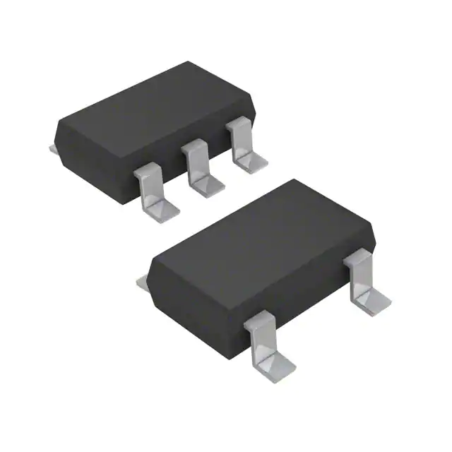
Voltage Regulators
TPS63000
ADP150
Output currents can go as high as 1200 mA
Voltage supply range 1.8V-5.5V
Power-Save Mode for Improved Efficiency
Cost - $0.85
Ultralow noise: 9 μV rms
Maximum output current: 150 mA
Cost - $1.36
Notes:
Frequency Synchronization, Light Load Efficiency,

Slide 32
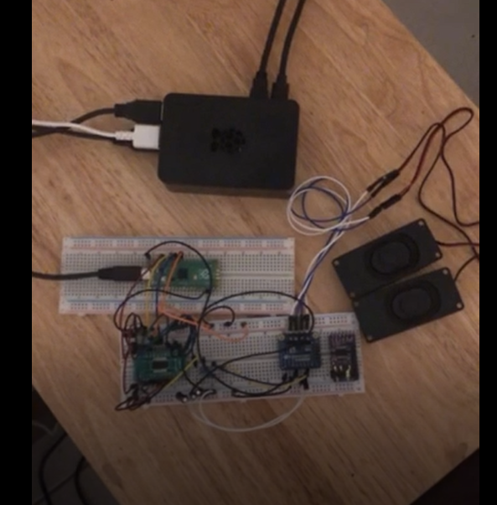
Prototyping For DAC
Initial prototyping was done using a raspberry pi pico to test the I2S interface connection with the PCM5122. This helped us to understand the sound function in our system.

Slide 33
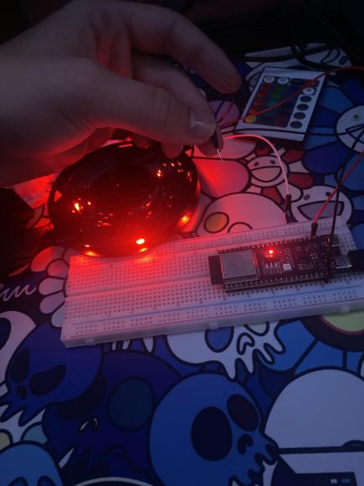
Prototyping For Lighting
Using the pico and esp32 development boards we tested programming for 4 wire and 3 wire led strips, to helps us in choosing the most efficient choice.

Slide 34
Problems & Solutions
Current issues
Reference oscillator isn't a higher enough frequency, selected audio file have to be resampled
The RP2040 is new, lacks a proprietary IDE, and therefore has uncommon library support
Software and GUI issues related to design and implementation
Possible solution
Code for no standard clock timing software, provide an standard external oscillator, or select a MCU that has a high reference clock oscillator
Coding around obscure libraries using logic our recontextualizing existing programs to fit our scope
Researching and seeking python support for our GUI or finding another language to write our GUI in
Notes:
During testing we ran into some problems, most noticeably with sound
Although the I2S interface is is simple in wiring, it can generate clocking issues with the pcm5122s PLL
when there is not system or master clock the PLL reads the Bit clock, and the Bit clock is being read from the RP2040 reference clock which is only 12MHz
This is causing sample rate issues requiring us to resample any standard file we use
Current solution includes Writing code for higher clock timing in software wich would allow us to use an external clock
or simply running a higher clock MCU, as we also tested with the ESP32-s3
Other issues involves the overall support for the RP2040 although the raspberry pi community has worked heavily on the RP2040 it is very new and does not have a native IDE
Luckily we have found very helpful libraries have been able to design around them
Another issue comes with gui development in python,
although python is an easy to code with language there isn't a lot of great Gui support when compared to other languages this has prompted us to do more research into the matter, or in the worst case use another language.

Slide 35
Upcoming tasks
Complete prototype
Order PCB
Finish Firmware
Finish Frontend
System Testing
Design Housing
Add Additional Features (Stretch Goals)

Slide 36
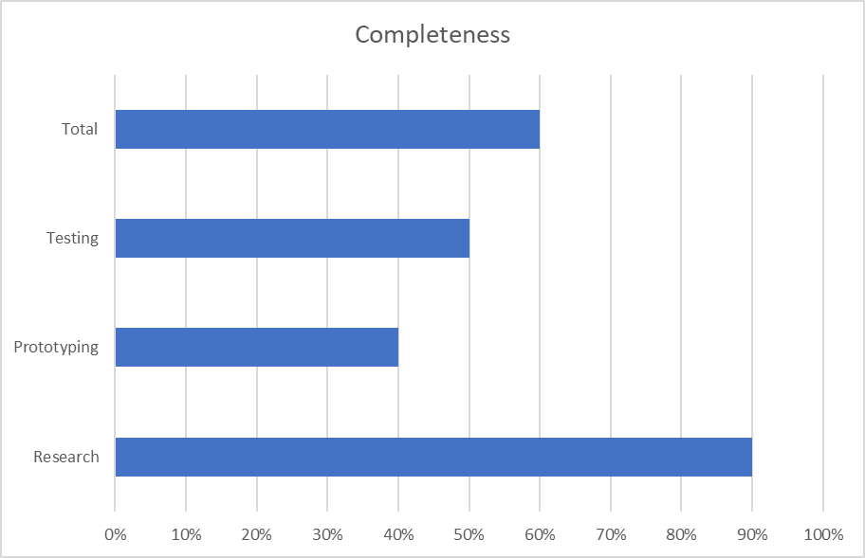
Progress

Slide 37
Questions?

